Slide 1
LOG-WO

Slide 2

LOG-WO TEAM

Slide 3

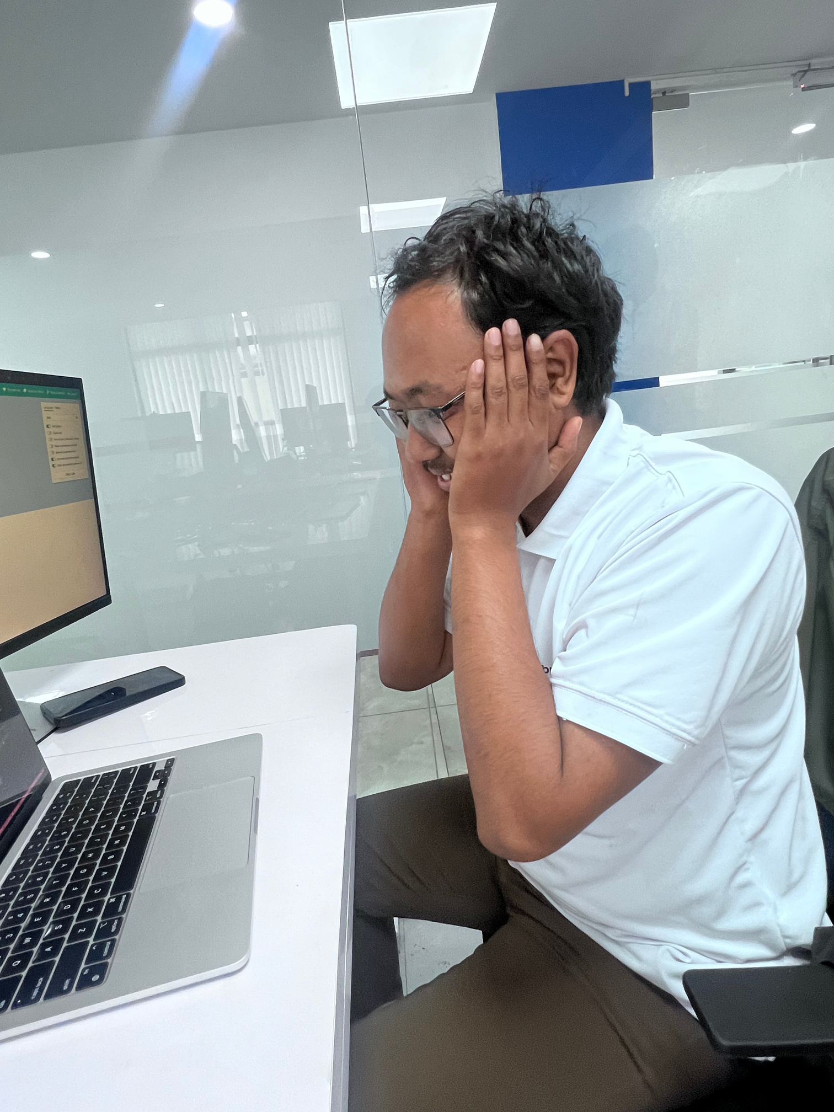
DEVELOPER: SUDHIR MANANDHAR

Slide 4
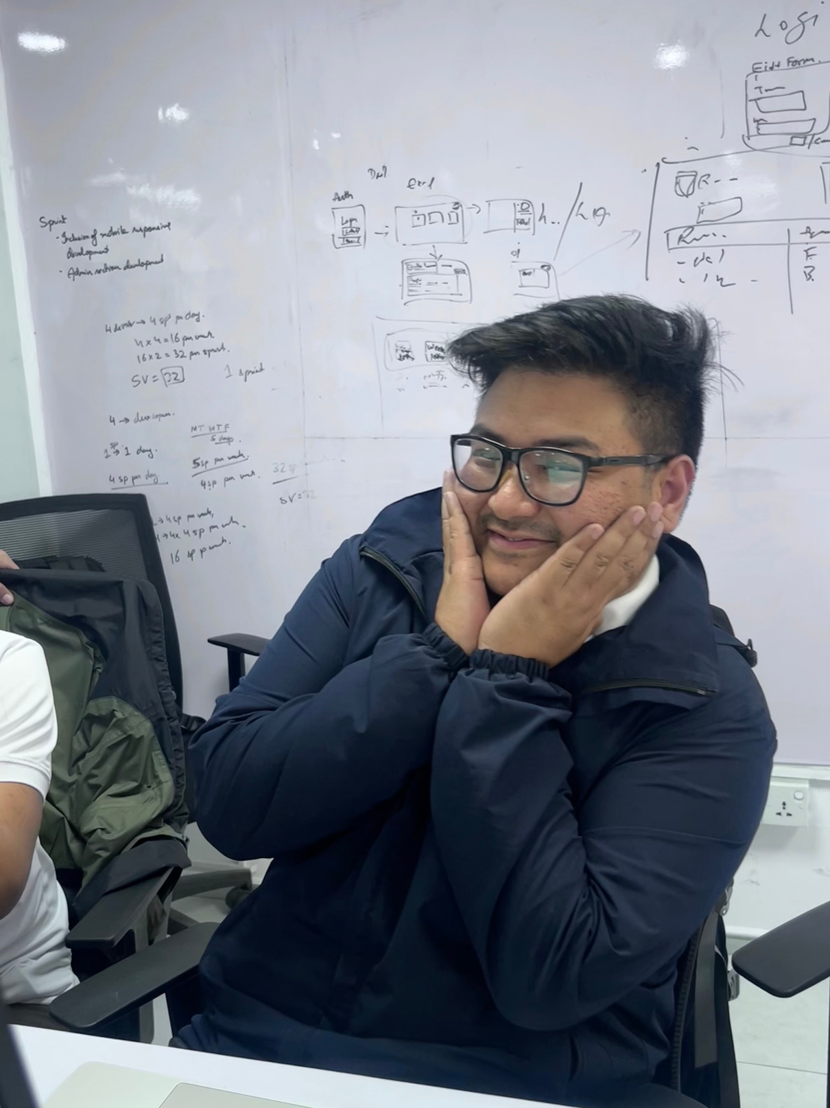
DEVELOPER: SUDIN SHRESTHA

Slide 5
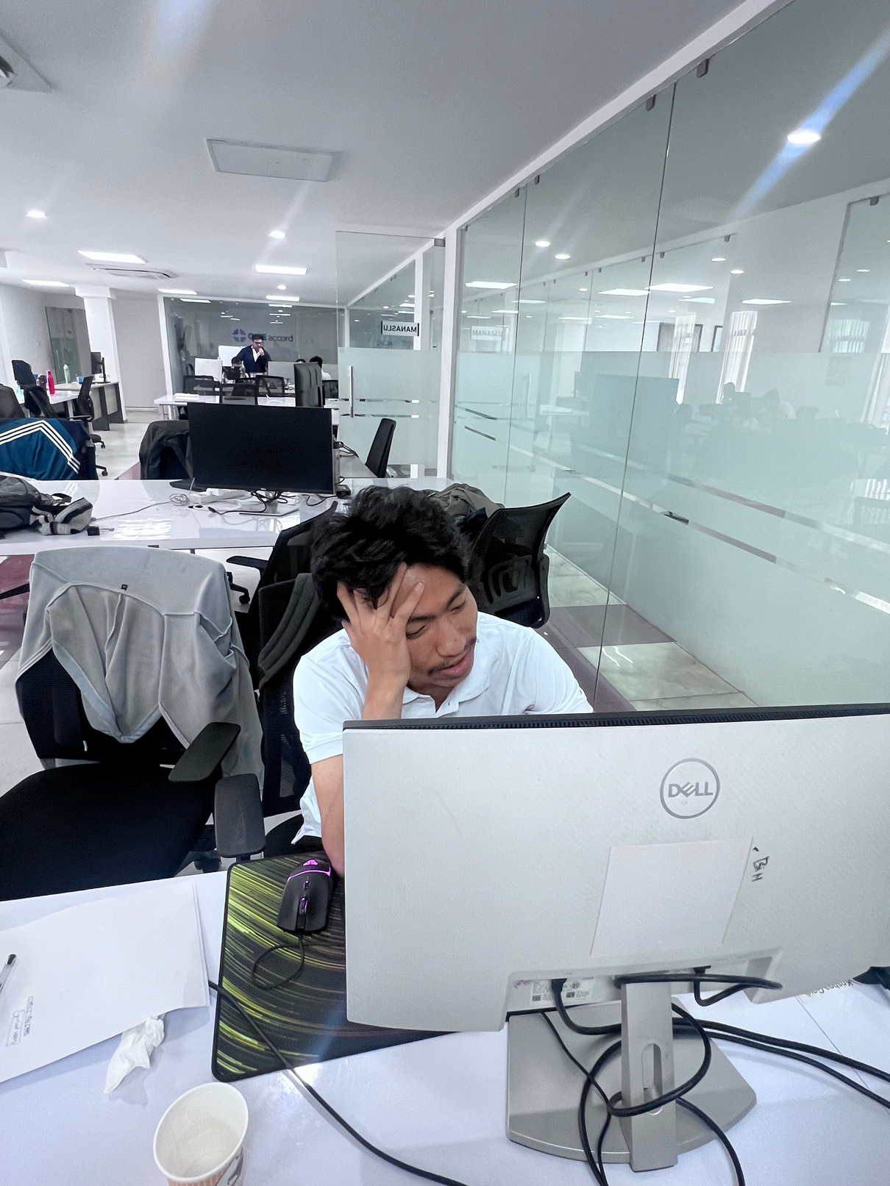
DEVELOPER: REASON SHRESTHA

Slide 6
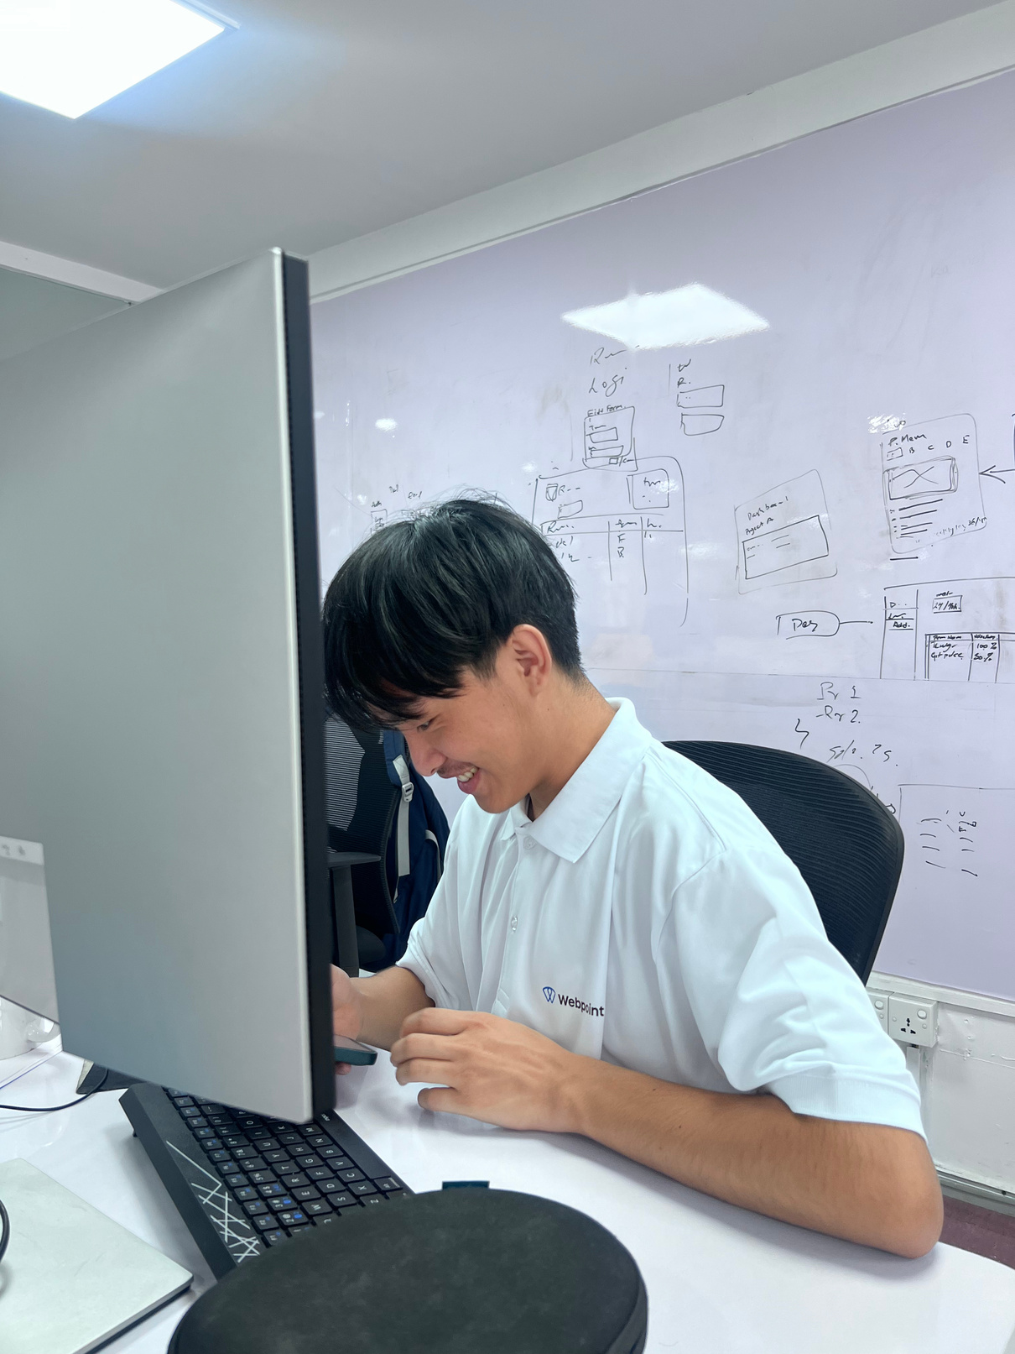
DESIGNER: KARMA TAMANG

Slide 7
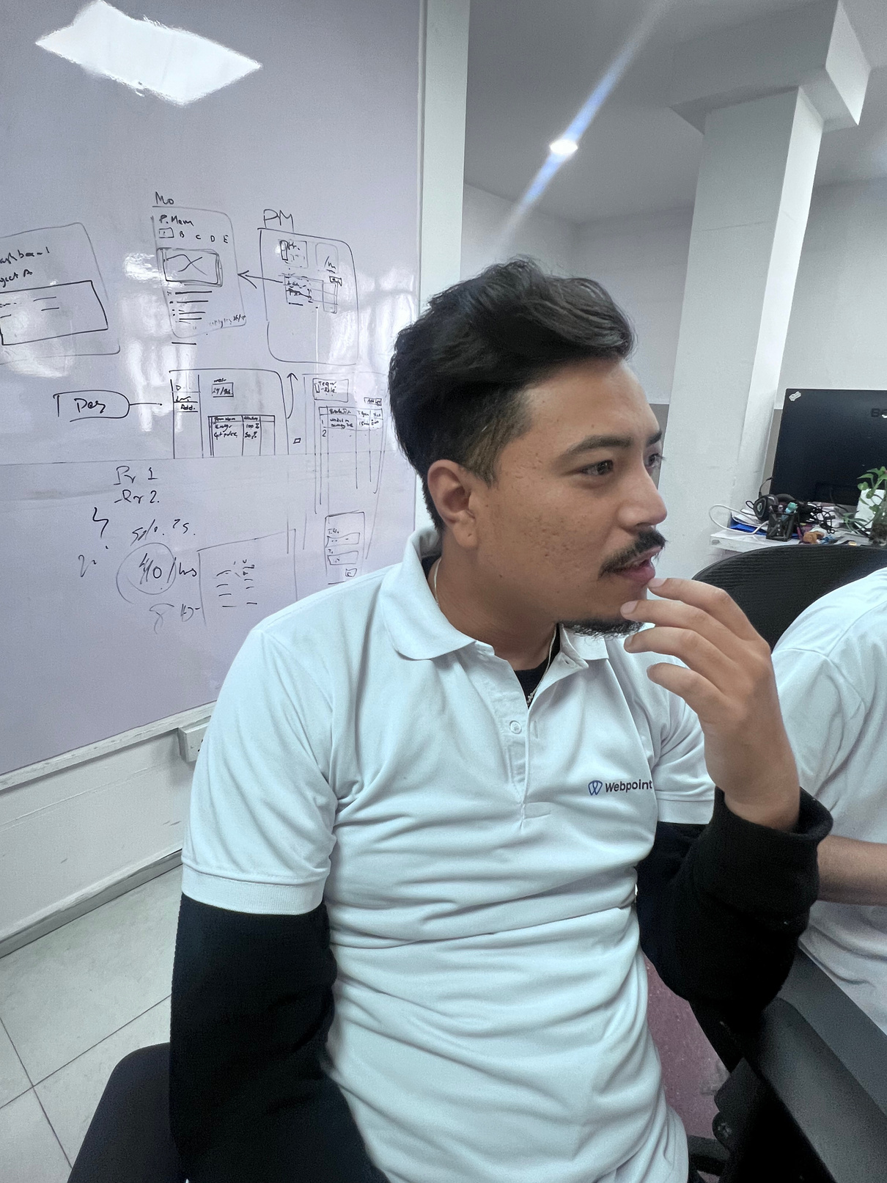
QA/CO-ORDINATOR: AABHUSHAN SHAKYA

Slide 8

PM: RENUKA SHIWAKOTI

Slide 9


WE WANTED TO TRACK OUR TIME, BUT SOMEHOW ENDED UP SPENDING MORE TIME TRACKING OUR TIME THAN DOING THE ACTUAL WORK.

Slide 10
WE BUILT THE PERFECT EXCEL WORKLOG SYSTEM, ONLY TO WATCH IT COLLAPSE UNDER ITS OWN WEIGHT WHEN EVERYONE STARTED USING THEIR OWN VERSION OF 'THE LATEST FILE.'

Slide 11

REIMAGINE WORKLOG WITH LOG-WO

Slide 12

AUTOMATED WORKLOG TRACKING
AUTO-RECORDS TIME USING COMMIT TIMESTAMPS
LINKS WORK TO TASKS VIA COMMIT MESSAGES
MINIMIZE MANUAL WORKLOG ENTRY
CREATES AUDITABLE TRAIL OF ACTUAL WORK
IMPROVES TRACKING COMPLIANCE
REDUCES DEVELOPER CONTEXT SWITCHING

Slide 13

TECHSTACK
BACKEND: NODE EXPRESS
FRONTEND: FLUTTER
DATABASE: POSTGRESQL

Slide 14
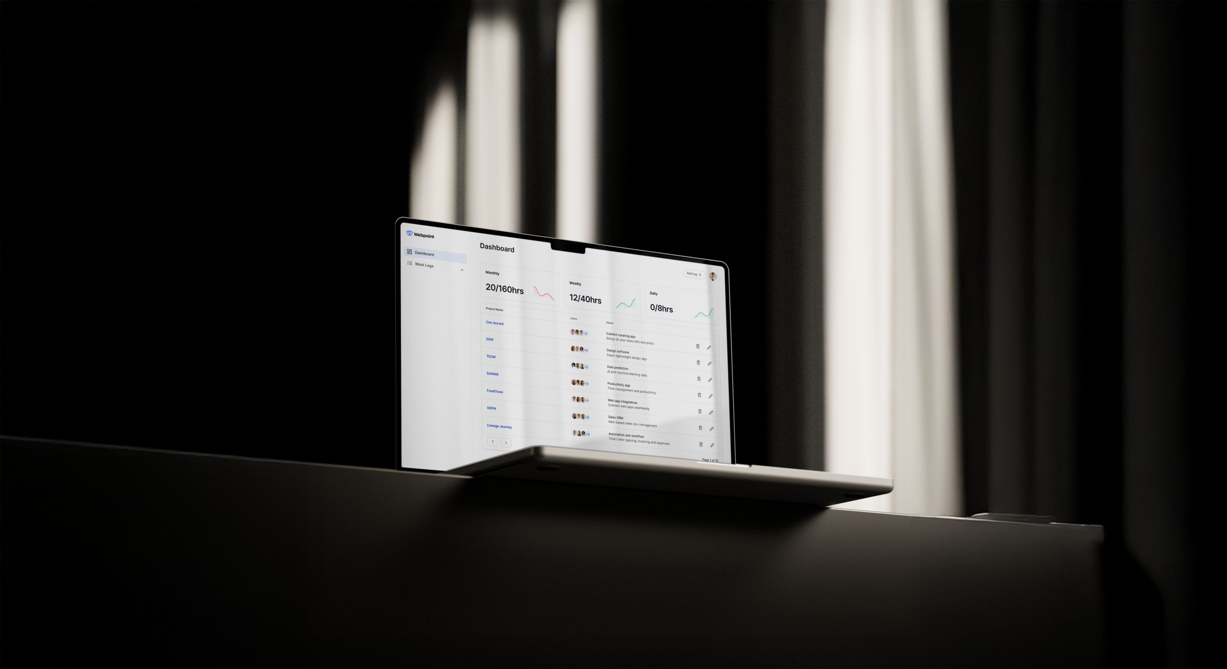

Slide 15
HOW TO USE LOG-WO

Slide 16
FUTURE ENHANCEMENTS

Slide 17
FUTURE ENHANCEMENTS
GOOGLE CALENDAR INTEGRATION
AI-BASED CATEGORIZATION
WORKLOG REMINDER
JIRA/ASANA INTEGRATIONS
ROLE-BASED ACCESS
DASHBOARDS AND FEATURES ARE TAILORED TO EACH TEAM ROLE—PMS GET FULL PROJECT OVERSIGHT AND TEAM MANAGEMENT TOOLS, DEVELOPERS ACCESS CODE REPOSITORIES AND TIME TRACKING, AND DESIGNERS AND QA HAVE ACCESS TO WORK-LOG MANAGEMENT
PERSONALIZED DASHBOARDS
PERSONALIZED DASHBOARD FOR DEVELOPERS, DESIGNERS, AND PROJECT MANAGERS BASED ON THEIR NEED

Slide 18

THANK YOU

